Slide 1



Data Structure
&
Algorithm
Class X
lab 8

Slide 2

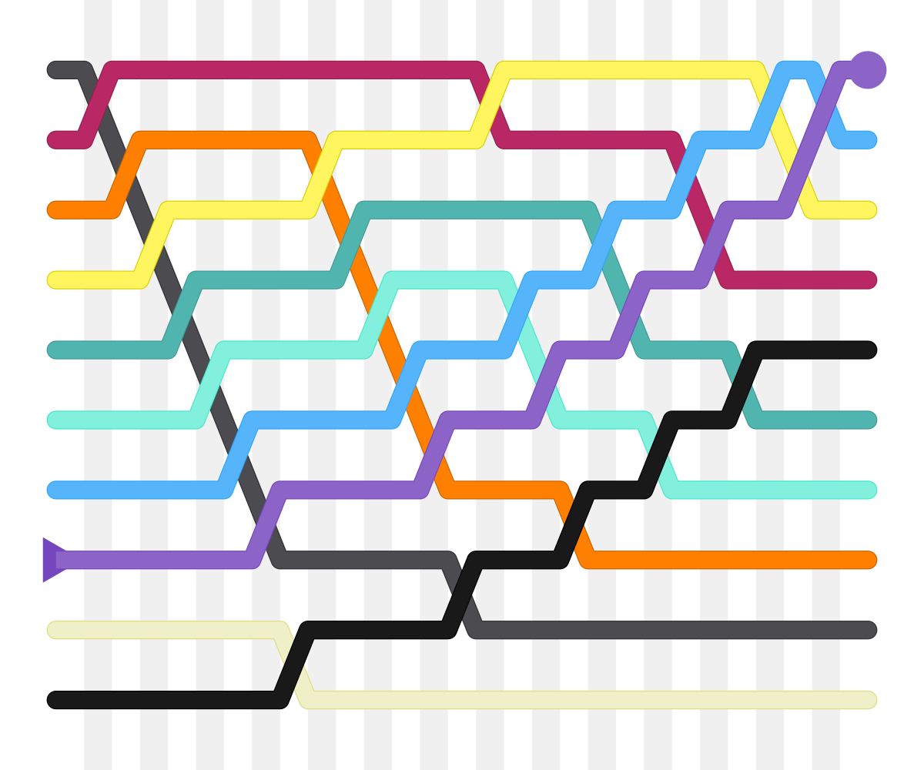
Bubble Sort
a simple sorting
algorithm

Slide 3
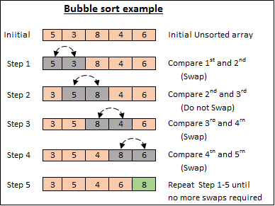
Bubble Sort Process

Slide 4
Bubble Sort Process

Slide 5
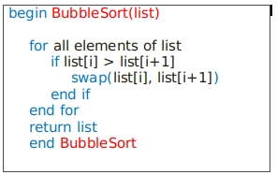
Bubble Sort Algorithm

Slide 6
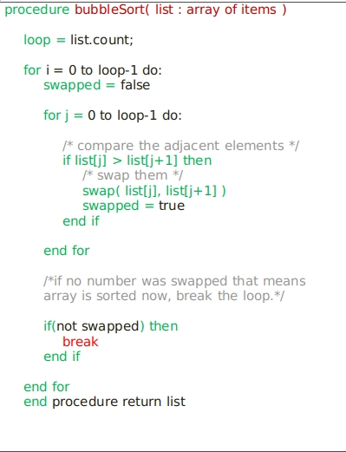
Bubble Sort Pseudocode

Slide 7


